Slide 1
Impact of a Comprehensive Lifestyle Peer Group-Based Intervention on CV Risk Frs: A Randomized Controlled Trial
Valentin Fuster MD, PhD,
on behalf of the
Fifty-Fifty Trial Investigators
AHA Annual Scientific Sessions 2015
Embargoed Until 10:45 a.m. ET, Monday, Nov. 9, 2015

Slide 2
Steering Committee
VALENTIN FUSTER, MD, PHD – PI AND STUDY CHAIRMAN
EMILIA GOMEZ, PhD - CO PI, RAMONA MARTINEZ, MSc VANESA CARRAL, PhD CARLA RODRIGUEZ, BA | SHE FOUNDATION, SPAIN
JUAN M. FERNANDEZ ALVIRA, PhD | CNIC, MADRID , SPAIN
RAJESH VEDANTHAN, MD, MPH SAMEER BANSILAL, MD, MS | ICAHN SCHOOL OF MEDICINE AT MOUNT SINAI, USA
TERESA ROBLEDO, MD | Spanish Agency for Consumer Affairs, Food Safety and Nutrition (AECOSAN), SPAIN
IÑAKI MARINA, MD | Catalan Health Institute, Spain

Slide 3
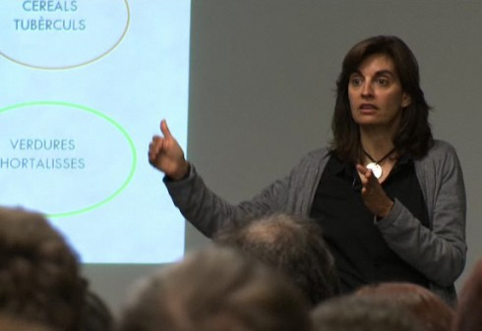
Study Hypothesis
Peer Support is a Proven Beneficial Strategy for Substance Abuse
Why not to Consider a Similar Peer Support
Strategy to Modify CV Global Risk Frs. & Behavior ?
Workshops
Peer Group
Assessment
Learning process

Slide 4
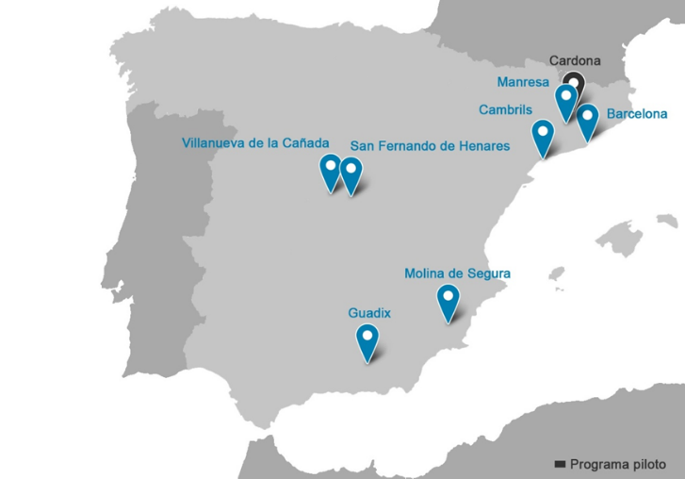
Background
Cardona (Barcelona)
Grenada Island
Community-based Program In
7 Municipalities (Spain)
Notes:
4
4

Slide 5
Study Recruitment
Multicenter, Randomized, Controlled Trial
Barcelona N=86
Manresa N=96
Cambrils N=69
N=648
Villanueva N=96
San Fernando N=104
Molina de Segura N=127
Guadix N=70

Slide 6
Selection of Participants
Inclusion criteria:
Age 25-50 yrs
Overweight or Obesity:
BMI ≥ 25 kg/m²
Physical inactivity:
<150’ exercise a week
Smoker
At baseline
High blood pressure:
BP≥140/90 mmHg or Rx
Exclusion criteria:
Pregnancy
Chronic Disease

Slide 7
Baseline Characteristics
 |  | Control Group N=266 | Intervention Group N=277
 |  | N (%) | N (%)
GENDER | Women | 189 (71) | 198 (72)
AGE | 25-29 | 17 (6) | 5 (2)
 | 30-39 | 78 (29) | 58 (21)
 | 40-50 | 171 (65) | 214 (77)
CV RISK FACTORS
 | Hypertension | 47 (18) | 60 (22)
 | Overweight/Obese | 218 (80) | 235 (85)
 | Smoking | 82 (31) | 85 (31)
 | Physically Inactive | 220 (83) | 221 (80)
EDUCATIONAL LEVEL | Low | 13 (5) | 15 (5)
 | Medium | 115 (43) | 146 (53)
 | High | 138 (52) | 116 (42)
FUSTER BEWAT SC |  | 8.3 (7.9-8.8) | 8.4 (8-8.8)

Slide 8
Study Design
SCREENING
BASELINE
FINAL ASSESSMENT
INTERVENTION= 277
FOLLOW-UP ASSESSMENTS
WORKSHOPS
CONTROL=266
1199 INVITED
648
ELIGIBLE
543
RANDOM.
16.2% FAILED RUN-IN
September 2013
January 2014
January 2015
January 2016
Notes:
intention-to-treat analysis, missing values for the BS after the randomization (drop-outs n=87) were assigned by means of multiple imputation (with gender, age and municipality as predictive variables). Mixed models accounting for municipality as random effects were used in order to determine whether the average score and/or the average score change at the end of the program were significantly different between the intervention and control groups controlling for the effects of other variables (namely gender, age, educational attainment and baseline score values).

Slide 9
The Intervention
Small peer groups of 10 individuals)
Leader selection for each group
Leaders Training
12 PEER GROUP meetings
6 Workshps
Intervention Group Participants
Monthly Meetings → 60 – 90 Min.

Slide 10
Outcome Measures 1
Fuster BEWAT Score: 0-3 Points Each Variable
. Blood Pressure
. Exercise
. Weight
. Alimentation
. Tobacco
Primaryary Outcome: Mean Change In BEWAT Score
Secondary Outcome: Mean Changes In Individual
Components Of BEWAT Score

Slide 11
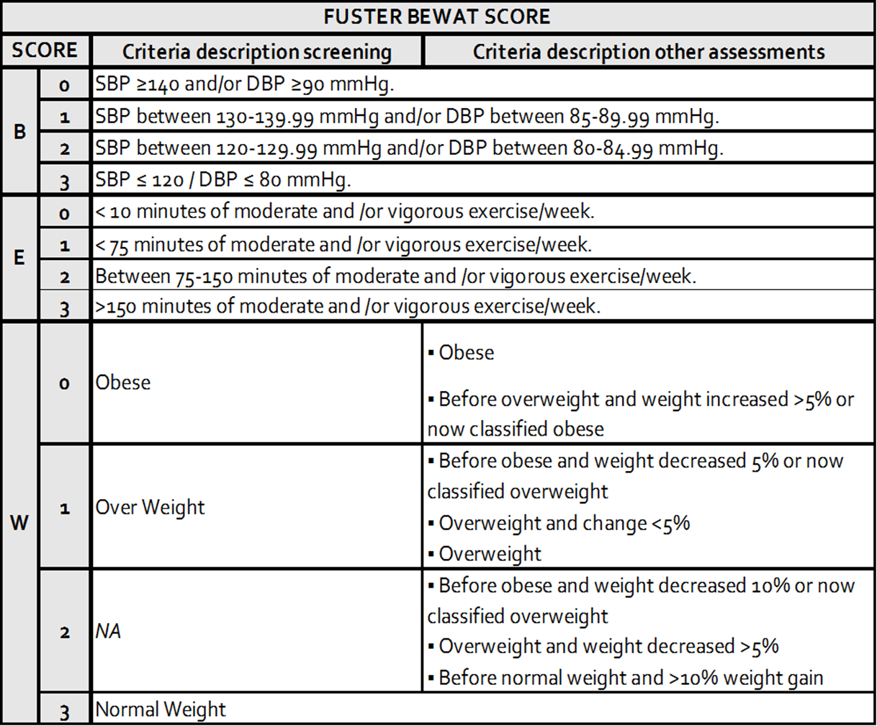
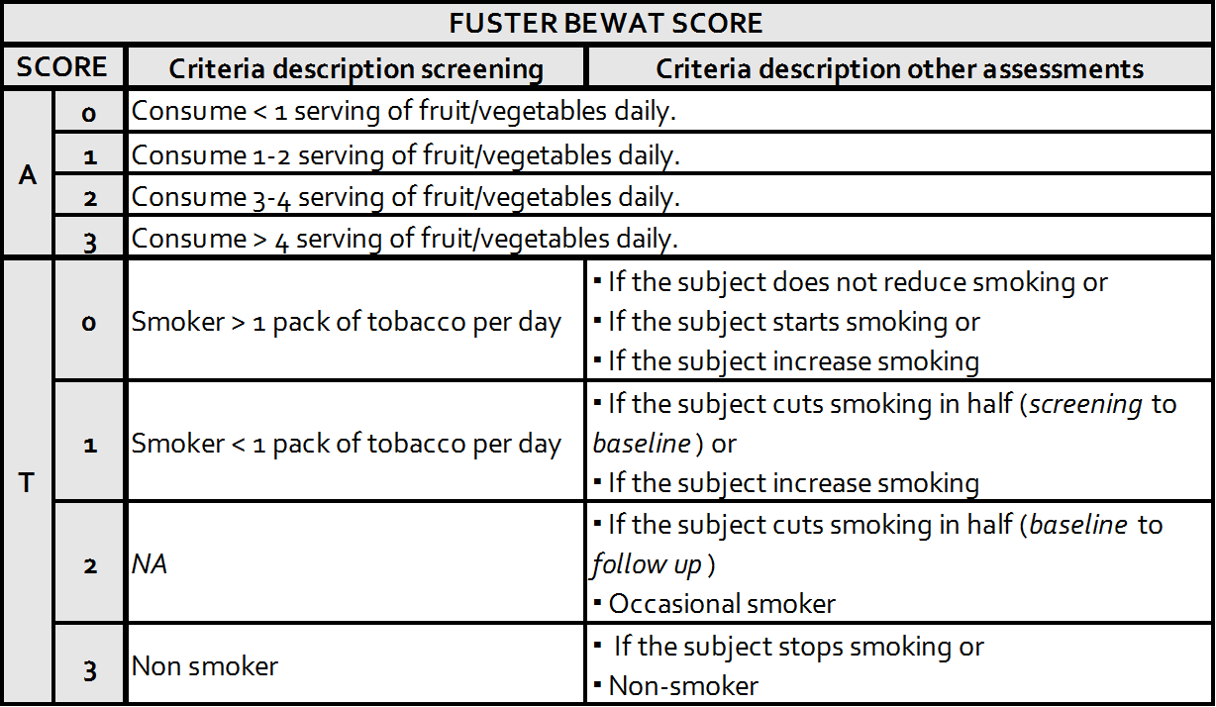
Outcome Measures 2

Slide 12
Primary Outcome - ITT

Slide 13
Secondary Outcome - ITT
P=0.003

Slide 14
High Vs. Low Adherence Mean Scores
(<7 Sessions vs ≥7 Sessions)
P= 0.14
P= 0.08

Slide 15
Limitations
Self-Reported Outcomes, Objective Too
Women 71%, Heterogeneus
Drop-out Rate 16%,
ITT - Multiple Imputation Analysis
(Gender, Age, Municipality),
Only participants, 4/5 Risk Frs p<0.05

Slide 16
Conclusions
The Fifty-Fifty peer group-based lifestyle management program had a positive impact on the participants showing an overall improvement of the BEWAT score and its behavioral components, especially smoking cessation.
Wider adoption of such a program may have a meaningful impact on CV health promotion.
A follow-up assessment will be performed one year after these final results to determine long-term sustainability of the improvements.

Slide 21
MEAN SCORES
Including Screening / Workshops
P=0.02
P=0.003

